Slide 1
November 2024
Introduction to C++:
Workshop Four
Dr. Alexander Hill
a.d.hill@liverpool.ac.uk

Slide 2
Last Week
Memory addresses and pointers
Passing vectors into functions
Basic saving of text-based data
Plotting with Python

Slide 3
Aim of Workshop Four
Homework recap
Classes in C++
Monte Carlo Background

Slide 4
Resources
alex-hill94.github.io/#WS4
https://www.w3schools.com/cpp/cpp_classes.asp

Slide 5
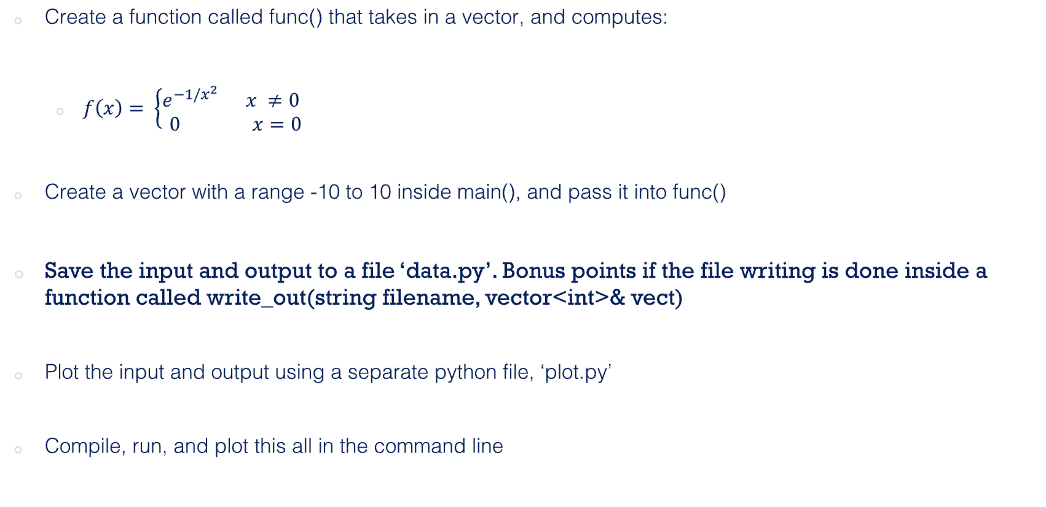
Challenge Six (Homework)
Create a function called func() that takes in a vector, and computes:
  $f\left(x\right)= \left\{\begin{aligned}e^{−1/x^{2}} x ≠0 \\ 0 x=0\end{aligned} \right.$
Create a vector with a range -10 to 10 inside main(), and pass it into func()
Save the input and output to a file ‘data.py’. Bonus points if the file writing is done inside a function called write_out(string filename, vector<int>& vect)
Plot the input and output using a separate python file, ‘plot.py’
Compile, run, and plot this all in the command line

Slide 6
Liam
#include <iostream>
#include <fstream>
#include <cmath>
#include <vector>
using namespace std;
void make(int n, int start, vector<int>& vect);
void func(const vector<int>& input, vector<double>& output);
void write_out(string filename, const vector<int>& input, const vector<double>& output);
void plot(string filename, string data);
int main(){
int n, start;
cout << "How many values would you like? \n";
cin >> n;
cout << "What value would you like to start with? \n";
cin >> start;
vector<int> x;
vector<double> out;
make(n, start, x);
func(x, out);
for (int j: x){
cout << "Values of x =" << j << "\n";
}
for (double j: out){
cout << "Values of f(x) = " << j << "\n";
}
string dataname = "data.py";
string plotname = "plot.py";
write_out(dataname, x, out);
plot(plotname, dataname);
return 0;
}
void make(int n, int start, vector<int>& vect){
int end = start + n;
for (int i = start; i < end; ++i){
vect.push_back(i);
}
}
void func(const vector<int>& input, vector<double>& output){
int n = input.size();
for (int i = 0; i < n; ++i){
if (input.at(i) == 0)
{
output.push_back(0);
}
else{
output.push_back(exp(-1/pow(input.at(i), 2)));
}}}

Slide 7
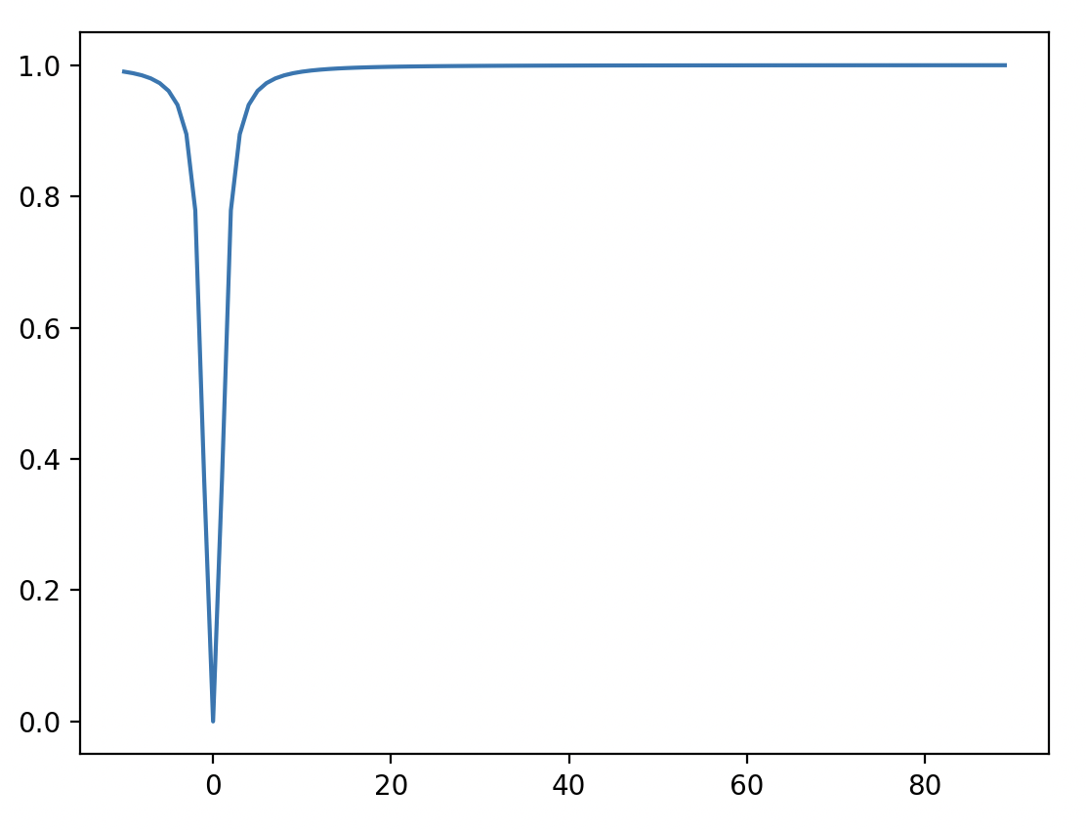
Liam
$ ./liam
How many values would you like?
100
What value would you like to start with?
-10
Values of x =-10
Values of x =-9
Values of x =-8
Values of x =-7
Values of x =-6
Values of x =-5
Values of x =-4
Values of x =-3
Values of x =-2
Values of x =-1
Values of x =0
Values of x =1
Values of x =2
Values of x =3
Values of x =4
Values of x =5
Values of x =6
Values of x =7
Values of x =8
Values of x =9
Values of x =10
Values of x =11
Values of x =12
Values of x =13
Values of x =14

Slide 8
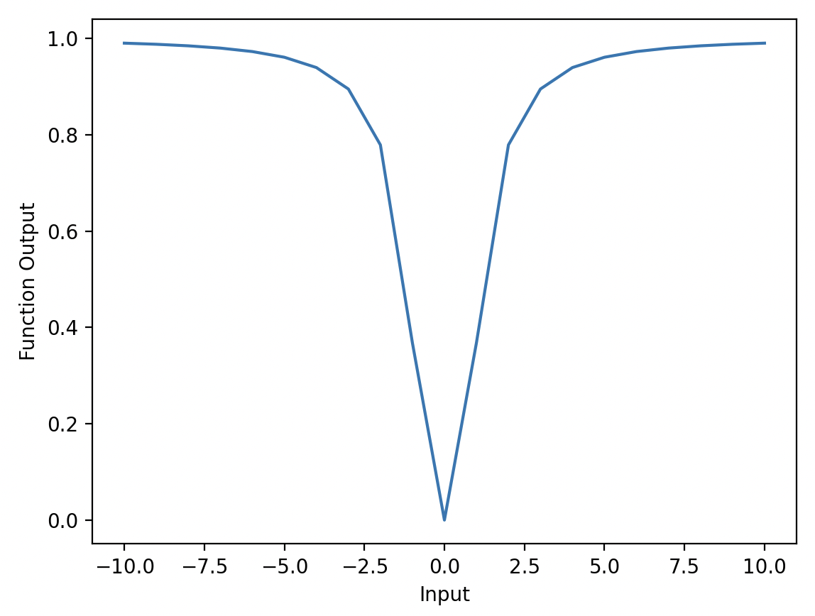
Jak
int main() {
// Generate vector with range -10 to 10
vector<int> inputVec;
for (int i = -10; i <= 10; i++) {
inputVec.push_back(i);
}
// Calculate output
vector<double> outputVec = func(inputVec);
// Write to file 'data.py'
write_out("data.py", inputVec, outputVec);
cout << "Data written to 'data.py'." << endl;
return 0;
}
// Function to get outputs
vector<double> func(const vector<int>& inputVec) {
vector<double> outputVec;
for (int x : inputVec) {
if (x != 0) {
outputVec.push_back(exp(-1/(x*x)));
} else {
outputVec.push_back(0);
}
}
return outputVec;
}

Slide 9
Jak
// Function to write input and output to python file
void write_out(const string& filename, const vector<double>& inputVec, const vector<double>& outputVec) {
ofstream file(filename);
if (file.is_open()) {
file << "# data.py\n";
file << "input_values = " << "[";
for (int i = 0; i < inputVec.size(); i++) {
file << inputVec[i] << (i < inputVec.size() - 1 ? ", " : "");
}
file << "]\n";
file << "output_values = " << "[";
for (int i = 0; i < outputVec.size(); i++) {
file << outputVec[i] << (i < outputVec.size() - 1 ? ", " : "");
}
file << "]\n";
file.close();
} else {
cerr << "Unable to open file";
}
}
condition ? expression_if_true : expression_if_false;

Slide 10
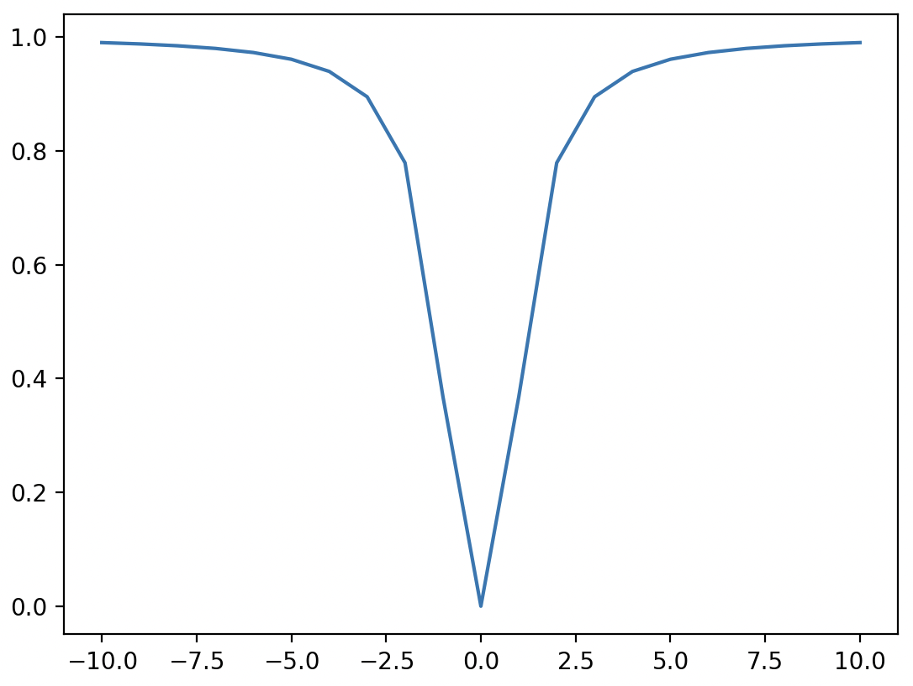
Naomi
(base) alexhill at Alexs-MacBook-Air-2 in ~/Documents/UOL/LIVINNO/Teaching/C++_Workshops/2024/WORKSHOPS/WS4/Naomi
$ ls
runplot.sh week3hw.cpp
(base) alexhill at Alexs-MacBook-Air-2 in ~/Documents/UOL/LIVINNO/Teaching/C++_Workshops/2024/WORKSHOPS/WS4/Naomi
$ bash runplot.sh
#!/bin/sh
g++ week3hw.cpp -o run
./run
python plot.py

Slide 11
Naomi
#include <iostream>
#include <cmath>
#include <vector>
#include <string>
#include <fstream>
using namespace std;
void write_out(string filename, vector<int>& input, vector<double>& output) {
ofstream myfile;
myfile.open (filename);
myfile << "import numpy as np" << "\n";
myfile << "import matplotlib.pyplot as plt" << "\n";
myfile << "x = np.array([" << "\n";
for (int i = 0; i < input.size(); ++i){
myfile << input[i] << ", ";
}
myfile << "])" << "\n";
myfile << "y = np.array([" << "\n";
for (int i = 0; i < output.size(); ++i){
myfile << output[i] << ", ";
}
myfile << "])" << "\n";
myfile << "plt.figure" << "\n";
myfile << "plt.plot(x, y)" << "\n";
myfile << "plt.show()" << "\n";
myfile.close();
}
void func(vector<int>& input, vector<double>& output) {
for (int i = 0; i < input.size(); ++i){
output[i] = exp(-1 / pow(input[i], 2));
}}
int main() {
// Create a vector of integers from -5 to 5
vector<int> input;
int k = 10;
for (int i = -k; i <= k; ++i) {
input.push_back(i);
}
vector<double> output(input.size());
func(input, output);
write_out("plot.py", input, output);
return 0;
}

Slide 12
Rosie
int main() {
//define input vector between -10 and 10
vector<double> input = {-10, -9, -8, -7, -6, -5, -4, -3, -2, -1, 0, 1, 2, 3, 4, 5, 6, 7, 8, 9, 10};
//pass input vector through func function to get output vector
vector<double> output = func(input);
//saving input and output vectors to the same data file
writeout("data.py", output, "output", true);
writeout("data.py", input, "input", false);
return 0;
}
void writeout(string filename, vector<double> writevector, string arrayname, bool overwrite){
//create file object
ofstream(datafile);
//open file, either overwriting or appending
if (overwrite == true) {
//open data file
datafile.open(filename);
datafile << "import numpy as np" << "\n"; //assumes that if you're appending to a file, it is already using numpy
}
if (overwrite == false) {
datafile.open(filename, fstream::app);
}
…………
…………

Slide 13
Challenge Six Solution: Alex
Modular Approach
#include <cmath>
#include <iostream>
#include <vector>
#include <fstream>
using namespace std;
void f_x(const double& x, double& fx)
{some stuff}
void f_master(const vector<double>& input, vector<double>& output)
{some stuff}
void write_out_vec(const string& filename, string& array_name , const vector<double>& output)
{some stuff}
int main()
{some stuff}

Slide 14
Alex
void f_x(const double& x, double& fx)
{
if (x == 0)
{
fx = 0;
}
else
{
fx = exp(-1/pow(x,2));
}
}
void f_master(const vector<double>& input, vector<double>& output)
{
double temp_val;
for (auto i: input){
f_x(i, temp_val);
output.push_back(temp_val);
}
}
New data type – automatically assigns a data type based on the initialisation
Fix the vector input
Create a temporary variable
temp_val is changed by f_x
Add new temp val to output vector

Slide 15
Alex
int main()
{
string filename = "data1.py";
double k;
cout << "n_vals = ?";
cin >> k;
double llim = -10;
double ulim = 10;
double seps = (ulim - llim)/(k - 1);
vector<double> x_range(k);
vector<double> fx_range;
for (int i =0; i < k; ++i)
{
x_range.at(i) = llim + (seps * i);
}
f_master(x_range, fx_range);
string x_lab = "x_range";
string fx_lab = "fx_range";
write_out_vec(filename, x_lab , x_range);
write_out_vec(filename, fx_lab , fx_range);
return 0;
}
Create input data
Compute function
Write vectors to file

Slide 16
Alex
Default value
void write_out_vec(const string& filename, string& array_name , const vector<double>& output, bool initialise = true)
// Writes out data in numpy form. If initialise == true, creates file from scratch and includes top lines needed
{
ofstream myfile;
if (initialise){
myfile.open (filename);
myfile << "import numpy as np" << "\n" << "\n";}
else{myfile.open (filename, std::ios_base::app);}
myfile << array_name << " = np.array((" << "\n";
for (auto i = 0; i < output.size(); ++i)
{if (i != (output.size() - 1))
{myfile << output.at(i) << ", " << "\n";}
else
{myfile << output.at(i) << "\n";}}
myfile << "))" << "\n";
myfile.close();}
Opens data file without wiping what’s already there
Loops over vector and writes out. If not at the end, then include comma

Slide 17
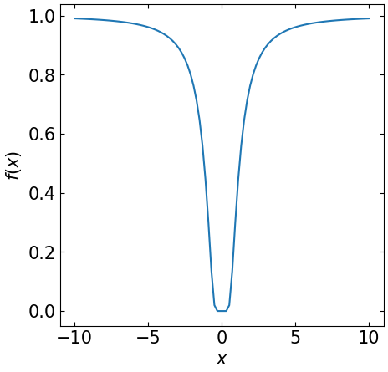
Alex
import matplotlib
import matplotlib.pyplot as plt
from data1 import *
FS = 15
matplotlib.rcParams.update({'font.size': FS})
fig, axs = plt.subplots(1,1, figsize = [5,5])
axs.plot(x_range, fx_range)
axs.set_xlabel('$x$')
axs.set_ylabel('$f(x)$')
axs.xaxis.set_tick_params(direction= 'in', which='both', right =True, top = True)
axs.yaxis.set_tick_params(direction= 'in', which='both', right =True, top = True)
plt.savefig('test.png',bbox_inches = 'tight', pad_inches = 0.05)

Slide 18
Takeaways
Use const to fix vectors when they go into functions where you are sure they shouldn’t be changed
Try to make your code easily adaptable
Try writing python inside a C++ script, and executing with bash or other command line languages

Slide 19
Challenge Seven
Aim: compute x^2 + 4x – 10 for an arbitrary input, save input/output data, plot the results
In main():
  Create an input vector x = (start, ….., end) with len(x) = k
  Set start = -100, end = 100, k = 1e6 initially
  Create a blank vector called output
  Pass input and output to a function func
  Pass input/output to a function called write_out
In func():
  Import memory addresses for input/output, i.e. don’t create copies
  Fix input, allow output to change
  Modify output according to x^2 + 4x – 10
In write_out():
  Save data to a named python script data.py
Python script:
  Load in data, plot results (you can do this inside a C++ function if you like)

Slide 20
Classes
Basics of Classes in C++
  Attributes and Methods
  Constructors
  Access specifiers

Slide 21

Object oriented programming
Procedural programming specifies the specific steps a programme must take
OOP creates objects that contain both data and functions
Why? DRY! (Don’t repeat yourself)

Slide 22




Classes and Objects
A ‘Class’ is a template for an ‘Object’
An ‘Object’ is an instance of a Class
E.g. for the ’Car’ class, you may have ‘Volvo’, ‘Audi’ and ‘Ford’ objects

Slide 23
Classes and Objects
Classes have attributes (variables, e.g. weight, colour)
Classes have methods (functions, e.g. brake, open door)
Attributes and functions are referred to as class members
Attributes
Methods

Slide 24
Classes: Attributes
Creates a class called Car
Determines how visible members of class are to the outside
#include <iostream>
using namespace std;
class Car { // The class
public: // Access specifier
int n_seats; // Attribute (int variable)
string brand; // Attribute (string variable)
string model; // Attribute (string variable)
};
int main() {
Car newcar; // Create an object of Car
// Access attributes and set values
newcar.n_seats = 5;
newcar.brand = "Seat";
newcar.model = "Ibiza";
// Print attribute values
cout << newcar.n_seats << "\n";
cout << newcar.brand << "\n";
cout << newcar.model << "\n";
return 0;
}
Creates some attributes
Creates object called newcar via the car class
Changes values of class attributes

Slide 25
Classes: Attributes
int main() {
Car peoplecarrier; // Create an object of Car
Car sportscar; // Create an object of Car
// Access attributes and set values
peoplecarrier.n_seats = 7;
sportscar.n_seats = 2;
return 0;
}
You can create multiple objects of a given class

Slide 26
Classes: Methods
Creates a function inside the class
Declare a function inside the class
#include <iostream>
using namespace std;
class Car {
public:
void Beep() {
cout << "Beep Beep" << endl;
};
int speed(int maxSpeed);
};
int Car::speed(int maxSpeed) {
return maxSpeed;
}
int main() {
Car myObj; // Create an object of Car
myObj.Beep();
cout << myObj.speed(200); // Call the method with an argument
return 0;
}
Define the function outside the class
Scope resolution operator ‘::’

Slide 27
Constructors
Constructor is called with the class name
Pass arguments to constructors when objects are created
#include <iostream>
using namespace std;
class Car { // The class
public: // Access specifier
string brand; // Attribute
Car(string x) { // Constructor with parameters
brand = x;
}
};
int main() {
// Create Car objects and call the constructor with different values
Car carObj1("BMW");
Car carObj2("Ford");
// Print values
cout << carObj1.brand << "\n";
cout << carObj2.brand << "\n";
return 0;
}
Constructors are special functions that are called whenever an object is created
You can also define constructors outside of a class

Slide 28
Access Specifier
Access specifiers can be:
Private: members cannot be viewed outside the class
Public: members are accessible outside the class
Protected: members cannot be accessed outside the class, however they can be accessed in inherited classes
By default, members are private
class Car {
public:
void Beep() {
cout << "Beep Beep" << endl;
}

Slide 29
Access Specifiers
#include <iostream>
using namespace std;
class MyClass {
public: // Public access specifier
int x; // Public attribute
private: // Private access specifier
int y; // Private attribute
};
int main() {
MyClass myObj;
myObj.x = 25; // Allowed (public)
myObj.y = 50; // Not allowed (private)
return 0;
}
$ g++ -std=c++11 -o soln lesson_ex.cpp
lesson_ex.cpp:14:9: error: 'y' is a private member of 'MyClass'
myObj.y = 50; // Not allowed (private)
^

Slide 30
Principles of OOP
Encapsulation
Inheritance

Slide 31
Encapsulation
Encapsulation ensures that code and data are in a black box (if desired)
You can use the ‘private’ access specifier to ensure this
It’s often the practice to use functions to retrieve (get) and define (set) attributes
Code
Data

Slide 32
Encapsulation
#include <iostream>
using namespace std;
class Employee {
private:
int salary;
public:
void setSalary(int s) {
salary = s;
}
int getSalary() {
return salary;
}};
int main() {
Employee myObj;
myObj.setSalary(50000);
cout << myObj.getSalary();
return 0;}
(base) alexhill at Alexs-Air in ~/Documents/UOL/Teaching/C++_Workshops/Workshops/WS4/Scripts
$ ./soln
50000

Slide 33
Inheritance
You can have multilevel inheritance (Grandparent -> Parent -> Child)
#include <iostream>
using namespace std;
// Base class
class Vehicle {
public:
string brand = "Ford";
void honk() {
cout << "Toot, toot! \n" ;}};
// Derived class
class Car: public Vehicle {
public:
string model = "Mustang";};
int main() {
Car myCar;
myCar.honk();
cout << myCar.brand + " " + myCar.model;
return 0;}
Derived class inherits from parent class using ‘:’ symbol
You can also have multiple inheritance, i.e.:
class MyChildClass: public MyClass, public MyOtherClass
$ ./soln
Toot, toot!
Ford Mustang

Slide 34
Inheritance: Access Specifiers
// Base class
class Employee {
protected: // Protected access specifier
int salary;
};
// Derived class
class Programmer: public Employee {
public:
void setSalary(int s) {
salary = s;}
int getSalary() {
return salary;
}}
‘Protected’ data can be accessed by the inherited class

Slide 35
Overriding base classes
#include <iostream>
using namespace std;
// Base class
class Animal {
public:
void animalSound() {
cout << "The animal makes a sound \n";
}
};
// Derived class
class Pig : public Animal {
public:
void animalSound() {
cout << "The pig says: weeee\n";
}
};
// Derived class
class Dog : public Animal {
public:
void animalSound() {
cout << "The dog says: woof \n";
}
};
int main() {
Animal myAnimal;
Pig myPig;
Dog myDog;
myAnimal.animalSound();
myPig.animalSound();
myDog.animalSound();
return 0;
}
$ ./soln
The animal makes a sound
The pig says: weee
The dog says: woof

Slide 36
Challenge Eight
Create a class called Country with attributes:
  Population, size, national language
Include a method called Greet, which outputs “Hello!”
In main(), create objects from the country class called: UK, France, Spain
Use constructors to initialise the attributes mentioned above
Print all attributes and run Greet
Bonus: inside Greet include an ‘if’ statement that changes language based on the national language

Slide 37
Monte Carlo Methods
History, general concepts
Quick example
Other examples

Slide 38
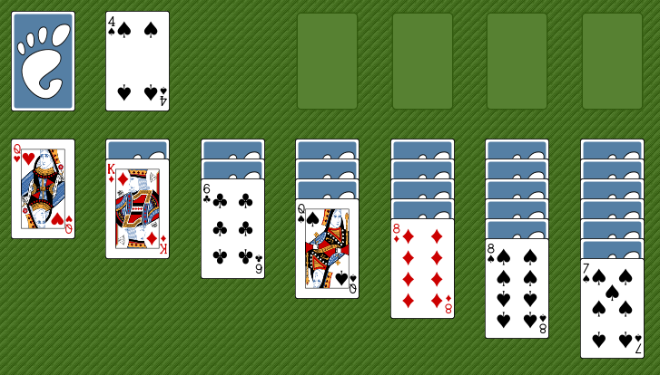
Monte Carlo History
Initially created by Stanislaw Ulam, Polish-American scientist
While ill, he wanted to know the probability of winning a game of solitaire
Finding the pure calculations too hard, he adopted a statistical approach
Playing the game would take too long, so he asked von Neumann to simulate it on an early (huge) computer

Slide 39
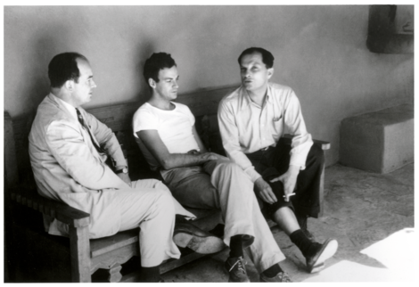
Monte Carlo History
John von Neumann
Stanislaw Ulam
The Monte Carlo Method is a mathematical technique used to estimate the outcomes of an uncertain event
Developed during WWII in relation to the Manhattan project
Named after the Monte Carlo Casino, frequented by Ulam’s uncle, as chance is important to the modelling approach
Idea: use random sampling of inputs to explore outputs complex systems

Slide 40
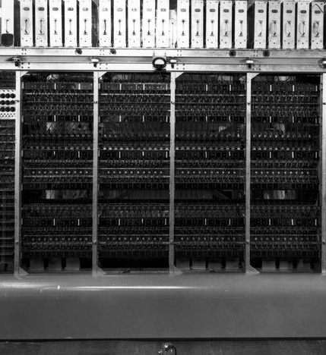

Monte Carlo History
The challenge of constructing the atom bomb involved neutron diffusion
Too challenging to be addressed analytically, needed a numerical approach
Some of the first computers tried an exhaustive numerical approach (plug in many numbers into the equation and calculate the result), but this was too slow due to high dimensionality of the problem
Monte Carlo methods were found to be remarkably successful
MANIAC Computer

Slide 41
Monte Carlo Basics
A method of estimating the value of an unknown quantity using the principles of inferential statistics
Key concepts:
  Population: the universe of possible examples
  Sample: a proper subset of a population
  A random sample tends to exhibit the same properties as the population from which it is drawn
  Use the sample to infer the statistics of the population
  As the variance of the population increases, the more samples are needed to reach the same degree of confidence

Slide 42
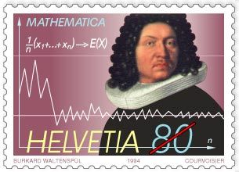
Law of Large Numbers
Law of large numbers:
  In repeated independent tests with the same probability, p, of a particular outcome in each test, the chance that the fraction of times that the outcome occurs differs from p converges to zero as the number of trials goes to infinity

Slide 43
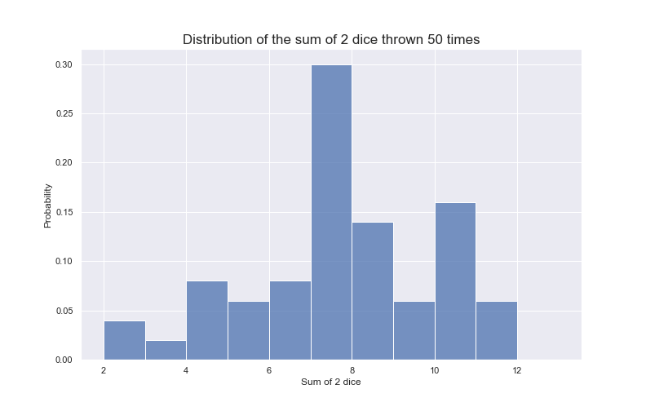
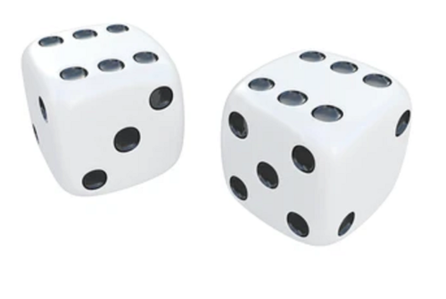
Law of large numbers
Example: roll two dice to predict probability of getting a given number in total

Slide 44
Next week
Monte Carlo with Classes

