Slide 1
November 2024
Introduction to C++:
Workshop Five
Dr. Alexander Hill
a.d.hill@liverpool.ac.uk

Slide 2
Last Week
Classes

Slide 3
Resources
alex-hill94.github.io/#WS5
https://www.w3schools.com/cpp/cpp_classes.asp
History of Monte Carlo - https://library.lanl.gov/cgi-bin/getfile?00326866.pdf
Basics of Monte Carlo Simulations - https://www.youtube.com/watch?v=OgO1gpXSUzU

Slide 4
Challenge Eight (Homework)
Create a class called Country with attributes:
Population, size, national language
Include a method called Greet, which outputs “Hello!”
In main(), create objects from the country class called: UK, France, Spain
Use constructors to initialise the attributes mentioned above
Print all attributes and run Greet
Bonus: inside Greet include an ‘if’ statement that changes language based on the national language

Slide 5
Archie
class Country{
public:
int population;
double size;
string language;
Country(int x, double y, string z){
population = x;
size = y;
language = z;
}
void greet();
};
void Country::greet(){
if(language == "French"){
cout << "Bonjour"<<endl;
}else{
if(language == "Spanish"){
cout << "Hola" << endl;
}else{
cout << "Hello" << endl;
}
}
}
int main(){
Country England(60,10,"English");
Country France (50,20,"French");
Country Spain (40,30,"Spanish");
cout<< "England population: "<< England.population << endl;
cout<<"England size: " << France.size << endl;
cout << "England greeting: ";
England.greet();
cout << "France population: " << France.population << endl;
cout << "France size: " << France.size << endl;
cout << "France greeting: ";
France.greet();
cout << "Spain population: " << Spain.population << endl;
cout << "Spain size: " << Spain.size << endl;
cout << "Spain greeting: ";
Spain.greet();
return 0;
}
Good use of constructors
$ ./a.out
England population: 60
England size: 20
England greeting: Hello
France population: 50
France size: 20
France greeting: Bonjour
Spain population: 40
Spain size: 30
Spain greeting: Hola
Clean class structure
If statements work, but are a little confusing

Slide 6
Shirsendu
class country{
public:
int population, size;
string national_language; country(int x, int y, string z){ population = x;
size = y;
national_language= z;
} void Greet(string l); };
void country::Greet(string l)
{ if(l=="English")cout<< "Hello"<<endl;
if(l=="French")cout<< "Bonjour"<<endl;
if(l=="Spanish")cout<< "Hola"<<endl;
}
int main()
{
country UK(67600000, 244376,"English"), France(66548530,547557, "French"), Spain(47473373,504782,"Spanish");
cout<<"Total population of UK is: "<<UK.population<<endl;
cout<<"Total population of France is: "<<France.population<<endl;
cout<<"Total population of Spain is: "<<Spain.population<<endl;
cout<<"\n"<<endl;
…
Good use of constructors
Total population of UK is: 67600000
Total population of France is: 66548530
Total population of Spain is: 47473373
Total size of UK is: 244376 sq km
Total size of France is: 547557 sq km
Total size of Spain is: 504782 sq km
National Language of UK is: English
National Language of France is: French
National Language of Spain is: Spanish
Hello
Bonjour
Hola
Clean class structure
What if national_language is not a match? Consider a default or a warning

Slide 7
Rosie
class country {
public:
int population;
int size;
string national_language;
country(int p, int s, string nl) {
population = p;
size = s;
national_language = nl;
}
void greet() {
if(national_language == "English") {
cout <<"Hello!" <<"\n";
}
if(national_language == "French") {
cout <<"Bonjour!" <<"\n";
}
if(national_language == "Spanish") {
cout <<"Hola!" <<"\n";
}
}
};
UK: 68350000, 243610, English
Hello!
France: 68170000, 551695, French
Bonjour!
Spain: 48370000, 506030, Spanish
Hola!
What if national_language is not a match? Consider a default or a warning

Slide 8
Ben
class Country {
public:
int population;
double size;
string national_language;
Country (int pop, double si, string nat_lang) {
population = pop;
size = si;
national_language = nat_lang;
}
void greet() {
if (national_language == "English") {
cout << "Hello!" << endl;
}
if (national_language == "French") {
cout << "Bonjour!" << endl;
}
if (national_language == "Spanish") {
cout << "Hola!" << endl;
}
}
};
$ ./a.out
1234234
2934.2
Spanish
Hello!
Bonjour!
Hola!
What if national_language is not a match? Consider a default or a warning

Slide 9
Structs
struct Point {
int x;
int y;
};
int main() {
Point p1;
p1.x = 10;
p1.y = 20;
std::cout << "Point p1: (" << p1.x << ", " << p1.y << ")" << std::endl;
return 0;
}
Similar to classes
Used mainly to group similar/related data
Structs can only inherit from other structs, not classes

Slide 10
Challenge Nine
Download https://alex-hill94.github.io/Workshop/Intro_to_C++/soln.cpp
Adapt this script so that the write_out function is replaced with a class
Use the constructor to create the data.py file, and use a method within the class to save the vectors

Slide 11
Headers
To avoid your script becoming too verbose, you can save useful functions and classes in a header file
Save this file as my_funcs.h, and import using #include “my_funcs.h”

Slide 12
Monte Carlo Methods
History, general concepts
Examples
Markov Chains

Slide 13
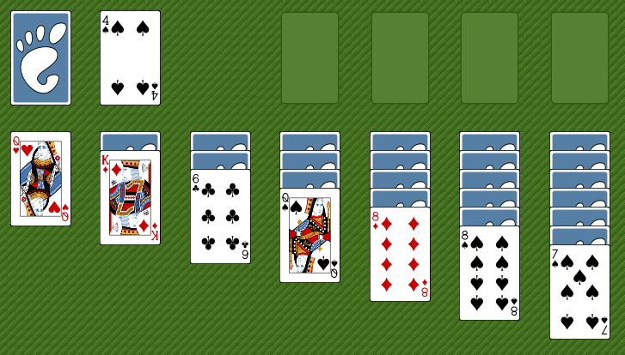
Monte Carlo History
Initially created by Stanislaw Ulam, Polish-American scientist
While ill, he wanted to know the probability of winning a game of solitaire
Finding the pure calculations too hard, he adopted a statistical approach
Playing the game would take too long, so he asked von Neumann to simulate it on an early (huge) computer

Slide 14
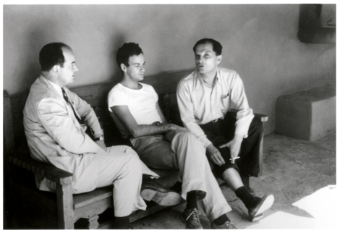
Monte Carlo History
John von Neumann
Stanislaw Ulam
The Monte Carlo Method is a mathematical technique used to estimate the outcomes of an uncertain event
Developed during WWII in relation to the Manhattan project
Named after the Monte Carlo Casino, frequented by Ulam’s uncle, as chance is important to the modelling approach
Idea: use random sampling of inputs to explore outputs complex systems

Slide 15
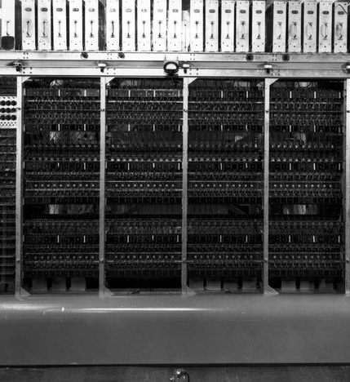
Monte Carlo History
The challenge of constructing the atom bomb involved neutron diffusion
Too challenging to be addressed analytically, needed a numerical approach
Some of the first computers tried an exhaustive numerical approach (plug in many numbers into the equation and calculate the result), but this was too slow due to high dimensionality of the problem
Monte Carlo methods were found to be remarkably successful
MANIAC Computer

Slide 16
Monte Carlo Basics
A method of estimating the value of an unknown quantity using the principles of inferential statistics
Key concepts:
Population: the universe of possible examples
Sample: a proper subset of a population
A random sample tends to exhibit the same properties as the population from which it is drawn
Use the sample to infer the statistics of the population

Slide 17
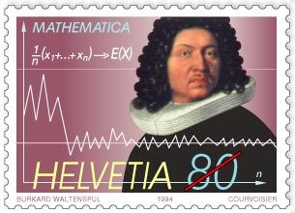
Law of Large Numbers
Law of large numbers:
In repeated independent tests with the same probability, p, of a particular outcome in each test, the chance that the fraction of times that the outcome occurs differs from p converges to zero as the number of trials goes to infinity
Notes:
Jacob Bernoulli

Slide 18
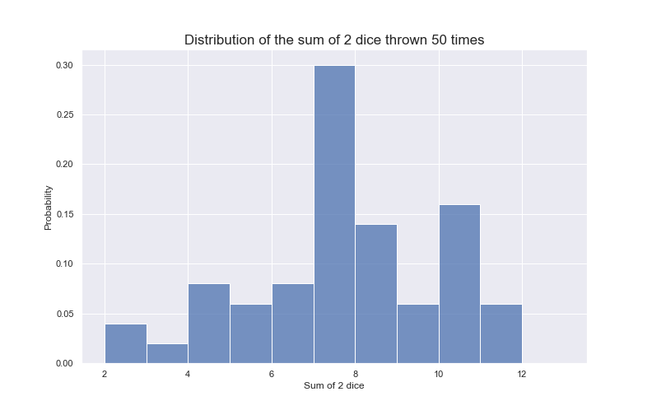
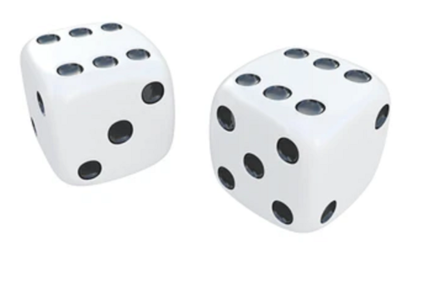
Law of large numbers
Example: roll two dice to predict probability of getting a given number in total

Slide 20
Regression to the Mean
Following an extreme, independent random event, the next random event is likely to be less extreme
Example: 10 reds in a row in roulette is $\frac{1}{2^{10}}$
In the next 10 spins, it is likely that you will get fewer than 10 reds (E[red] = 5)
For the 20 spins in total, you will get closer to the expected mean of 50% reds than you had in the first 10 spins
Subtly different to the gambler’s fallacy…

Slide 21
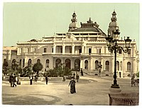
Gambler’s Fallacy
This is the idea that following a statistically unlikely set of results (e.g. many instances of red in a row in roulette), people believe that the next sample will work to bring you back to the average
Example in 1913 at Monte Carlo casino: after 15 blacks in a row, there was a rush to bet on red
After 26 reds in a row, the casino had made a fortune

Slide 22
How many samples do we need?
Depends on the sample variance:
Var $= \frac{\sum_{x∈X}{{(x − μ)}^{2}}}{N}$
$σ=\sqrt{\frac{\sum_{x∈X}{{(x − μ)}^{2}}}{N}}$
The larger the variance, the more samples you need to accurately estimate the distribution

Slide 23
Monte Carlo Experiments
Generate random inputs according to some distribution
Use these to conduct an experiment
Analyse the output using statistics and make predictions of the simulation’s or process’ properties

Slide 24
Monte Carlo Examples
Business applications:
Estimate probability of cost overrun in large projects
Estimate likelihood of an asset gaining/losing value
Path tracing in video games (trace random samples of possible light paths)
AI for video games (tree search for next best move)
Computational physics, physical chemistry

Slide 25
Random Numbers
For random events, the probability that any given random event occurs is given via probability distribution function
This captures the notion of relative frequency with which random events occur
For discrete random events (heads, tails), the sum of the probability of each value occurring must add up to one
For continuous events (temperature) it’s trickier, as we can’t give infinite real numbers separate probability values

Slide 26
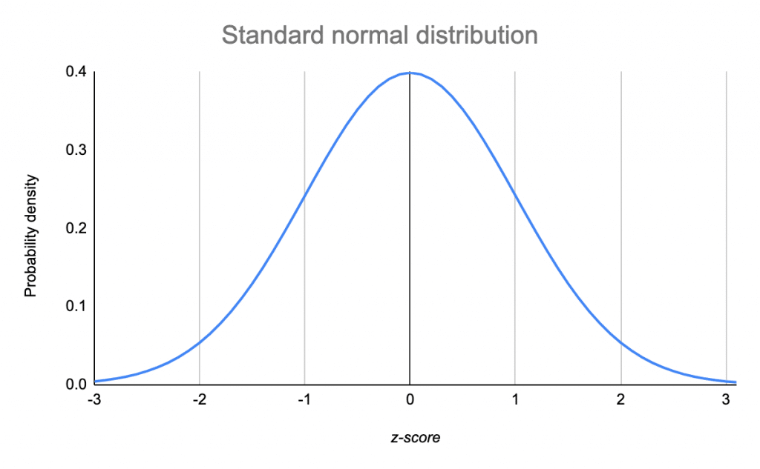
Continuous random variables
Continuous random events are defined using a probability density function
This gives the probability of a random variable lying between two values
It defines a curve in $x−y,$ where the range spanned by $x$ are the possible values, and the area under the curve between two points gives the probability that a sample will fall in that range

Slide 27
Generating Random Numbers in C++
We’ll use the <random> header to generate random numbers (https://cplusplus.com/reference/random/)
This uses Generators and Distributions to generate random numbers
Generator: an object that generates uniformly distributed numbers
Distribution: an object that transforms sequences of generated numbers into numbers numbers that follow a specific random variable distribution

Slide 28
Generating Random Numbers in C++
Create a random number seed
Create a generator using the seed
Create a distribution object
Pass the generator into the distribution

Slide 29
Generating random numbers in C++
Generator: mersenne twister random number engine
Start and end points
#include <iostream>
#include <vector>
#include <random>
using namespace std;
int main(){
const int range_from = 0;
const int range_to = 1000;
random_device rand_dev;
mt19937 generator(rand_dev());
uniform_int_distribution<int> distr(range_from, range_to);
cout << distr(generator) << '\n';
return 0;
}
Seed: this creates a random device object, which is used to seed the random number generator
Uniform integer distribution
Distribution definition
Distribution takes Generator as argument to produce random number

Slide 30
Example
#include <iostream>
#include <vector>
#include <random>
#include <cmath>
#include <fstream>
#include "funcs.h"
using namespace std;
int main(){
int n_sim_runs = 1e5;
vector<double> inputs(n_sim_runs);
vector<double> outputs;
string fname = "data.py";
string xname = "x_range";
string yname = ”y_range";
for (auto i = 0; i < inputs.size(); ++i){
rnum(inputs.at(i));
}
simulation(inputs, outputs);
write_out_vec(fname, xname, inputs);
write_out_vec(fname, yname, outputs, false);
system("ipython test.py &");
return 0;
}
Some auxiliary functions I’ve made
A ‘simulation’ takes one input (uniform dist.) and produces one output
What is the output distribution?
Create inputs with length ‘n’
Blank outputs
Replaces inputs elements with random numbers
Runs ‘simulation’, outputs is now the simulation’s output
Writes out data
Runs plotting python script

Slide 31
Example
void rnum(double& input){
const double range_from = -1000;
const double range_to = 1000;
random_device rand_dev;
mt19937 gen(rand_dev());
uniform_real_distribution<double> distr(range_from, range_to);
input = distr(gen);
}
Random number function takes an element the the input vector, and makes it a random float between -1000 and 1000

Slide 32
Example
Input is fixed, output can change
void buffer(const double& input, double& output){
// Computes a polynomial from a given input, modifies the output accordingly
output = pow(input, 3) - 3*pow(input, 2) + 9.2 * pow(input,1) + 4.3;
}
void simulation(const vector<double>& input, vector<double>& output)
{
// Simulation loops over inputs and modifies the output vector
double temp_val;
for (auto i: input){
buffer(i, temp_val);
output.push_back(temp_val);
}
}

Slide 33
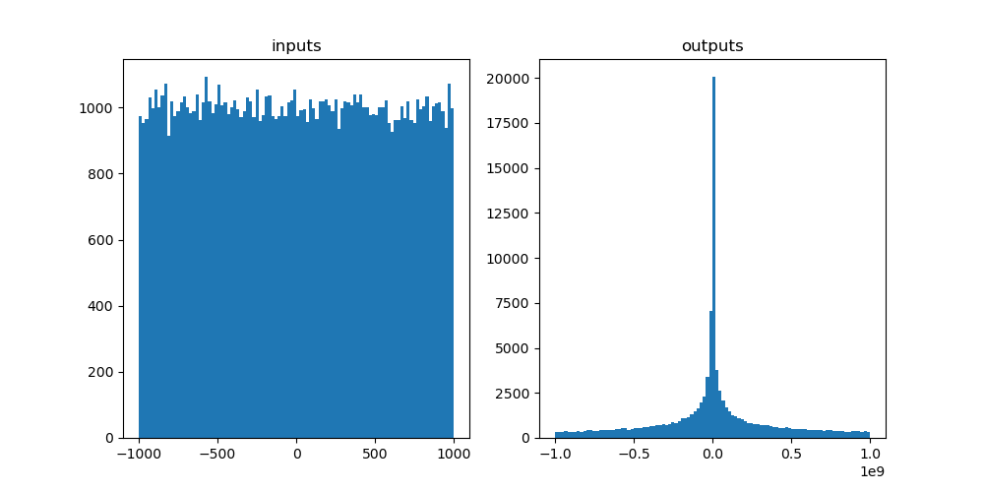
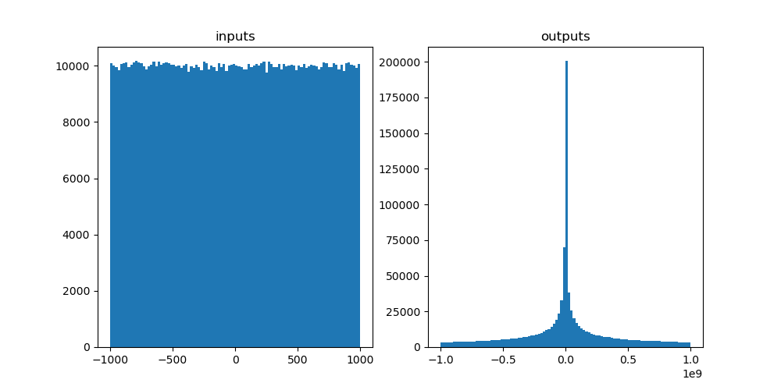
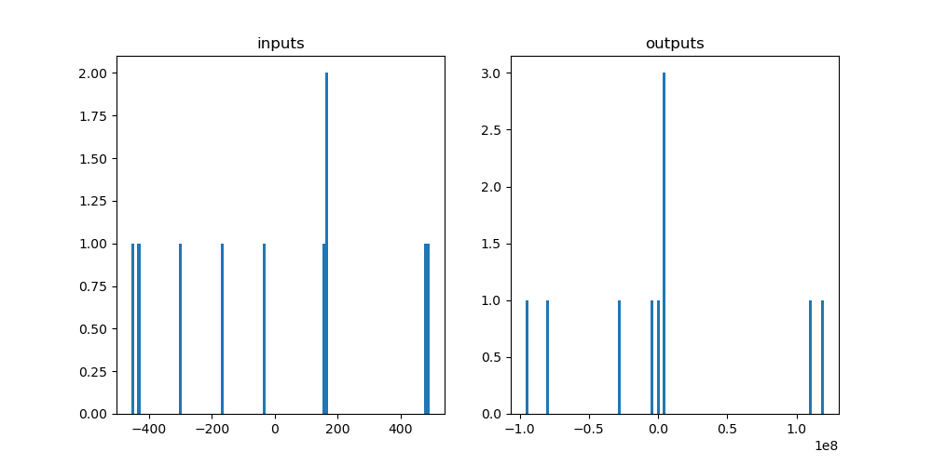
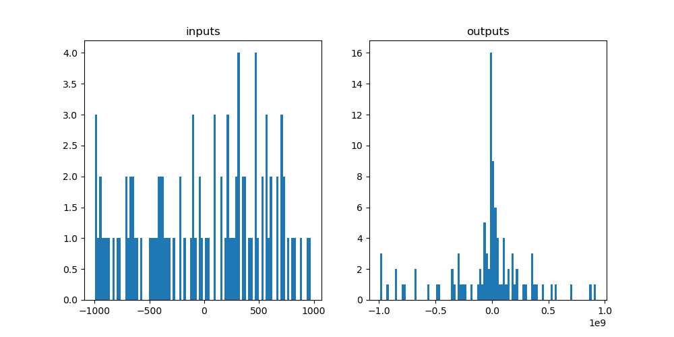
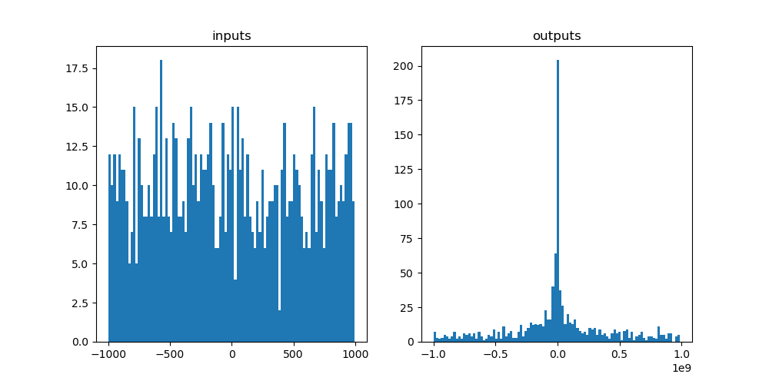
Example
1e1 -> 1e6 draws

Slide 34
Challenge Ten: Area of a Circle
0.5
For the circle described by $x^{2}+y^{2}={0.5}^{2}$, compute its area using a Monte Carlo method
i.e. draw random $x$ and $y$ between -0.5 and 0.5, and compute the fraction of draws that satisfy $x^{2}+y^{2}<{0.5}^{2}$
How many draws do you need to get ~1% error on $πr^{2}$ ?
-0.5
0.5
-0.5

Slide 35
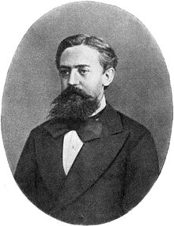
Markov Chain Monte Carlo (MCMC)
Monte Carlo: estimate the expected value or probability density of some unknown space by drawing independent random values
For high-dimension probabilistic models, Monte Carlo sampling may not be effective, as volume of sample space grows exponentially with additional parameters
MCMCs try to sample more intelligently, the next random draw depends on the current one
Andrey Markov

Slide 36
Markov Chains
0.9
A simple Markov Chain uses stochastic processes to determine the evolving state of a system
Consider this system, it describes whether someone attends class given their previous attendance
E.g. if you attend class one week, there’s a 90% chance you will the next
Attend
0.1
0.6
TO
Skip
attend
skip
0.4
attend
$$\begin{matrix}0.9 & 0.1 \\ 0.6 & 0.4\end{matrix}$$
FROM
skip
Transition matrix

Slide 37
Markov Chains
0.9
Start with initial state of attendance: $X_{0}=\left[1,0\right]$
$X_{1}=X_{0}T=[0.9, 0.1]$
$X_{2}=X_{1}T=[0.87, 0.13]$
In the long-run, you approach a steady state, i.e. $X_{n+1}=X_{n}$
Attend
0.1
0.6
TO
Skip
attend
skip
0.4
attend
$$\begin{matrix}0.9 & 0.1 \\ 0.6 & 0.4\end{matrix}$$
FROM
skip
Transition matrix

Slide 38
Markov Chains
0.9
$X_{s}−X_{s}T=0$
$X_{s}\left(I −T\right)=0$
$\left[x, y\right]\left(\begin{matrix}0.1 & −0.1 \\ −0.6 & 0.6\end{matrix}\right)=0$
$0.1x−0.6y=0$ and $x+y=1$
$X_{s}=\left[\frac{6}{7},\frac{1}{7}\right]$
Attend
0.1
0.6
TO
Skip
attend
skip
0.4
attend
$$\begin{matrix}0.9 & 0.1 \\ 0.6 & 0.4\end{matrix}$$
FROM
skip
Transition matrix

Slide 39
Markov Chains
Markov chains can also be used to generate a sequence of random variables where the current value is dependent on the value of the prior value
MCMCs are Monte Carlo methods where a Markov chain is used to draw samples
The idea is that the chain will settle (find equilibrium) on the desired quantity we are inferring

Slide 40
Challenge Eleven
Create a class that generates random numbers from a uniform distribution
Create a Markov Chain class that predicts which US party will win the next election (lookup matrices, matrix mutliplication, if statements etc.)
Assume initially a Dem is in power X0 = [1,0], create a method in the MC class that calculates numerically the steady state vector, i.e. the probability that in a given year the holder will be Democrat or Republican
Create another method that uses random draws from the random number class to stochastically predict who will be in power for each of the next 20 cycles
Create a figure showing how the holder of office changed over the 20 cycles
0.76
Democrat
0.24
0.35
0.65
Republican

Slide 41
Next week
Introduction to your group project

Slide 42
Thanks!

