Slide 1
November 2024
Introduction to C++:
Workshop Six
Dr. Alexander Hill
a.d.hill@liverpool.ac.uk

Slide 2
Last Week
Monte Carlo Basics
Generating random numbers in C++

Slide 3
Aim of Workshop Six
Homework recap
Markov Chains
Group Project

Slide 4
Resources
alex-hill94.github.io/#WS6 for lecture slides
alex-hill94.github.io/#Proj for project description and a potentially useful C++ script
Previous lecture slides for details on random numbers, classes, functions, etc.
https://cplusplus.com/reference/random

Slide 5
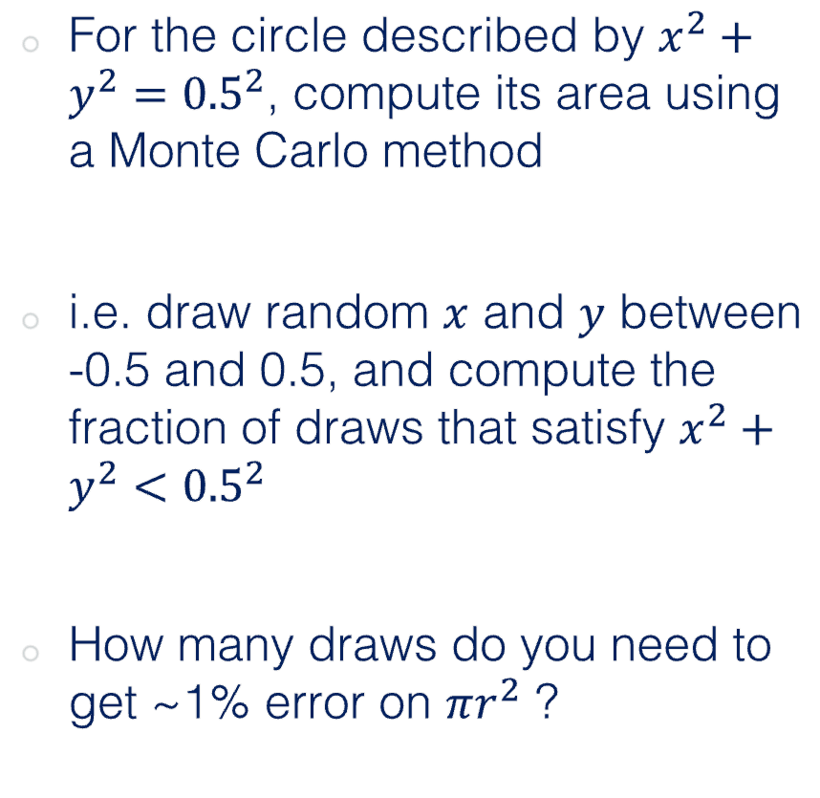
Challenge Ten (Homework)
For the circle described by $x^{2}+y^{2}={0.5}^{2}$, compute its area using a Monte Carlo method
i.e. draw random $x$ and $y$ between -0.5 and 0.5, and compute the fraction of draws that satisfy $x^{2}+y^{2}<{0.5}^{2}$
How many draws do you need to get ~1% error on $πr^{2}$ ?
0.5
-0.5
0.5
-0.5

Slide 6
Ben
double getRadius(double x, double y) {
return sqrt(x * x + y * y);
}
int main(void) {
// Specify number of steps
int steps;
cout << "Number of steps: ";
cin >> steps;
// Define variables
double x;
double y;
double r;
int count = 0;
double area;
double error;
const double start = -0.5;
const double end = 0.5;
const double radius = (end - start) / 2;
// Random number generator
random_device rand_dev;
mt19937 generator(rand_dev());
uniform_real_distribution<double> distribution(start, end);
// Monte Carlo simulation
for (int i = 0; i < steps; ++i) {
x = distribution(generator);
y = distribution(generator);
r = getRadius(x, y);
if (r < radius) {
count++;
}
}
// Calculate estimated area and error
area = double(count) / steps;
error = 100*(1 - area/M_PI_4);
// Print results
cout << "Estimated area: " << area << endl;
cout << "Target area: " << M_PI_4 << endl;
cout << "Error: " << error << "%" << endl;
return 0;
}
Area of square = 1, so fraction of hits does equal area estimate
M_PI_$ = PI * 0.5**2
$ ./a
Number of steps: 10
Estimated area: 0.9
Target area: 0.785398
Error: -14.5916%
$ ./a
Number of steps: 1000
Estimated area: 0.798
Target area: 0.785398
Error: -1.60452%
$ ./a
Number of steps: 10000000
Estimated area: 0.785342
Target area: 0.785398
Error: 0.00718914%
Nicely set up RNG

Slide 7
Naomi
double randomiser(mt19937& generator, const double& range_from, const double& range_to) {
uniform_real_distribution<double> distr(range_from, range_to);
return distr(generator);
}
int main() {
double min = -5;
double max = 5;
double area = 0;
double true_area = 0.25 * M_PI;
double n = 1000;
vector<double> x;
vector<double> y;
random_device rand_dev;
mt19937 generator(rand_dev());
// Seed the generator to see how things change! for some reason it's the same for all values unless you stick 1 in the generator?
int seed;
cout << "Enter a seed value: ";
cin >> seed;
generator.seed(seed);
while (abs((area / n) - true_area) / true_area > 0.01) {
int new_points = n * 2;
x.reserve(x.size() + new_points);
y.reserve(y.size() + new_points);
for (int i = 0; i < new_points; ++i) {
double new_x = randomiser(generator, min, max);
double new_y = randomiser(generator, min, max);
x.push_back(new_x);
y.push_back(new_y);
if (pow(new_x, 2) + pow(new_y, 2) <= 25) {
area += 1;
}
}
n += new_points;
}
write_out("data.py", "x", x, true).write();
write_out("data.py", "y", y, false).write();
cout << "The area of the circle is: " << (area / n)<< " units\u00B2" << endl;
cout << "The true area of the circle is: " << true_area << " units\u00B2" << endl;
cout << "number of iterations: " << n << endl;
return 0;
}
Something going wrong with the while statement and n+=new_points I think
$ ./a
Enter a seed value: 404
The area of the circle is: 0.782115 units²
The true area of the circle is: 0.785398 units²
number of iterations: 243000
$ ./a
Enter a seed value: 8
The area of the circle is: 0.781938 units²
The true area of the circle is: 0.785398 units²
number of iterations: 243000

Slide 8
John
int main(){
int n_sim_runs = 10;
const double radius = 0.5;
double sim_frac;
double error = 100.0;
double error_thresh = 1.0;
circle my_circle(radius);
while (error > error_thresh) {
vector<double> x_inputs(n_sim_runs);
vector<double> y_inputs(n_sim_runs);
vector<double> outputs(n_sim_runs);
for (auto i = 0; i < x_inputs.size(); ++i){
random_num(x_inputs.at(i), radius);
random_num(y_inputs.at(i), radius);
}
my_circle.calculate_area(x_inputs, y_inputs, outputs);
sim_frac = my_circle.calculate_fraction(outputs, radius);
error = my_circle.calculate_error(sim_frac);
n_sim_runs = n_sim_runs*2;
}
cout << "Final number of runs = " << n_sim_runs << endl;
cout << "Fraction = " << sim_frac << endl;
cout << "Final error = " << error << "%" <<endl;
cout << "Actual area: " << my_circle.actual_area << endl;
return 0;
}
$ ./a
Final number of runs = 2560
Fraction = 0.78125
Final error = 0.528161%
Actual area: 0.785398
Inefficient to bin the 10, 20, 40,… computations before convergence

Slide 9
John
class circle {
public:
double radius;
double actual_area;
circle(double r){
radius = r;
actual_area = M_PI*pow(r,2);}
void calculate_area(const vector<double>& x_inputs, const vector<double>& y_inputs, vector<double>& outputs){
for (auto i = 0; i < x_inputs.size(); ++i){
outputs.at(i) = pow(x_inputs.at(i), 2) + pow(y_inputs.at(i), 2);}}
double calculate_fraction(const vector<double>& areas, const double radius){
int count = 0;
double fraction;
for (double a : areas) {
if (a < pow(radius,2)) {
count++;}}
fraction = static_cast<double>(count) / areas.size();
return fraction;}
double calculate_error(double sim_frac){
double error = (abs(actual_area - sim_frac) / actual_area) * 100.0;
return error;}};
Not actually calculating the area, more a point’s position on a plot
This only works with r = 0.5, as in this case sim_frac == estimated area

Slide 10
Matthew
int main() {
float square_area = 4 * radius * radius;
// Random number generator
random_device rand_dev;
mt19937 generator(rand_dev());
uniform_real_distribution<double> distr(-radius, radius);
vector<double> x_init(num_elements), y_init(num_elements), x_final, y_final;
// Fill vectors with random values
for (int i = 0; i < num_elements; ++i) {
x_init[i] = distr(generator);
y_init[i] = distr(generator);
}
// Discard points outside the circle
for (int i = 0; i < num_elements; ++i) {
if (x_init[i] * x_init[i] + y_init[i] * y_init[i] <= radius * radius) {
x_final.push_back(x_init[i]);
y_final.push_back(y_init[i]);
}
}
// Calculate the areas
double estimated_area = circle_area_estimation(x_final, y_final, square_area);
double actual_area = true_circle_area(radius);
cout << "Estimated Area = " << estimated_area << endl;
cout << "True Area = " << actual_area << endl;
cout << "Error = " << calculate_error(estimated_area, actual_area) << "%" << endl;
return 0;
}
const int num_elements = 1500;
// Function to calculate the estimated area based on the Monte Carlo simulation
double circle_area_estimation(const vector<double>& x_inside, const vector<double>& y_inside, float square_area) {
double ratio = static_cast<double>(x_inside.size()) / num_elements;
return ratio * square_area;
}
Multiplying fraction by square_area makes this work
$ ./a
Estimated Area = 0.793333
True Area = 0.785398
Error = 1.01034%
Would have even been better to show decreasing error with increasing draws

Slide 11
Rosie
double random_number(const double min, const double max) {
//srand(time(0));
double rn = ((double)rand()) / RAND_MAX;
double rnir = min + ((max - min)*rn);
return rnir;}
int circle(const double radius) {
double x = random_number((-0.5), 0.5);
double y = random_number((-1*radius), radius);
double eq = pow(x,2) + pow(y,2);
//cout <<x <<y;
if(eq < pow((radius), 2)) {
return 1;}
else {return 0;}}
int main() {
double r = 0.5;
double actual_area = pow(r, 2)*M_PI;
double square_area = pow((2*r),2);
double sample_size = 3300;
double points_in_circle = 0;
for(double i = 0; i < sample_size-1; ++i) {
if(circle(r) == 1){
++points_in_circle;}}
double in_vs_out = points_in_circle/sample_size;
double MC_area = in_vs_out*square_area;
double error = abs(((actual_area - MC_area)/actual_area)*100);
cout <<"actual area: " << actual_area << "\n"<< "MC area: " << MC_area << "\n"<< "error: " << error <<"%";
return 0; }
Potential for error up here
$ ./a
actual area: 0.785398
MC area: 0.785152
error: 0.0314042%
Nice and concise

Slide 12
Shoaib
int main(){
int n_sim_runs =1e4;
double range_from=-0.5;
double range_to = 0.5;
double radius = 0.5;
double total_area = 1.0;
vector<double> x_val(n_sim_runs);
vector<double> y_val(n_sim_runs);
for (auto i = 0; i < x_val.size(); ++i){
rnum(x_val.at(i), range_from, range_to);
rnum(y_val.at(i), range_from, range_to);
}
int inside_circle = draw(x_val, y_val);
double area= total_area*inside_circle/n_sim_runs;
double diff=(2*100*abs(M_PI*pow(radius, 2)-area))/(total_area+area);
if (diff < 1) {
cout << "Total draws = " << n_sim_runs << "\n";
cout <<"Passed draws = " << inside_circle << "\n";
cout << "Area of Circle = " << area << "\n";
cout << "Percentage Diff = " << diff << "%";}
else{
cout << "Try again or increase number of iterations " << "\n" ;
}
return 0;
}
Total draws = 10000
Passed draws = 7789
Area of Circle = 0.7789
Percentage Diff = 0.730582%
// function to generate random number
void rnum(double& input, const double ini_val, const double fin_val){
random_device rand_dev;
mt19937 gen(rand_dev());
uniform_real_distribution<double> distr(ini_val, fin_val);
input = distr(gen);
}
// function to calculate draws that satisfy give condition
int draw(const vector<double>& input1, const vector<double>& input2){
int count=0;
for (int i=0; i< input1.size(); ++i){
if (pow(input1.at(i),2)+pow(input2.at(i),2) < pow(0.5,2)) {
count=count+1;
}}
return count;
}
Consider passing radius as an argument

Slide 13
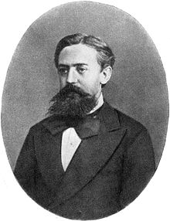
Markov Chain Monte Carlo (MCMC)
Monte Carlo: estimate the expected value or probability density of some unknown space by drawing independent random values
For high-dimension probabilistic models, Monte Carlo sampling may not be effective, as volume of sample space grows exponentially with additional parameters
MCMCs try to sample more intelligently, the next random draw depends on the current one
Andrey Markov

Slide 14
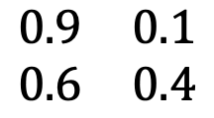
Markov Chains
0.9
A simple Markov Chain uses stochastic processes to determine the evolving state of a system
Consider this system, it describes whether someone attends class given their previous attendance
E.g. if you attend class one week, there’s a 90% chance you will the next
Attend
0.1
0.6
TO
Skip
attend
skip
0.4
attend
$$\begin{matrix}0.9 & 0.1 \\ 0.6 & 0.4\end{matrix}$$
FROM
skip
Transition matrix

Slide 15
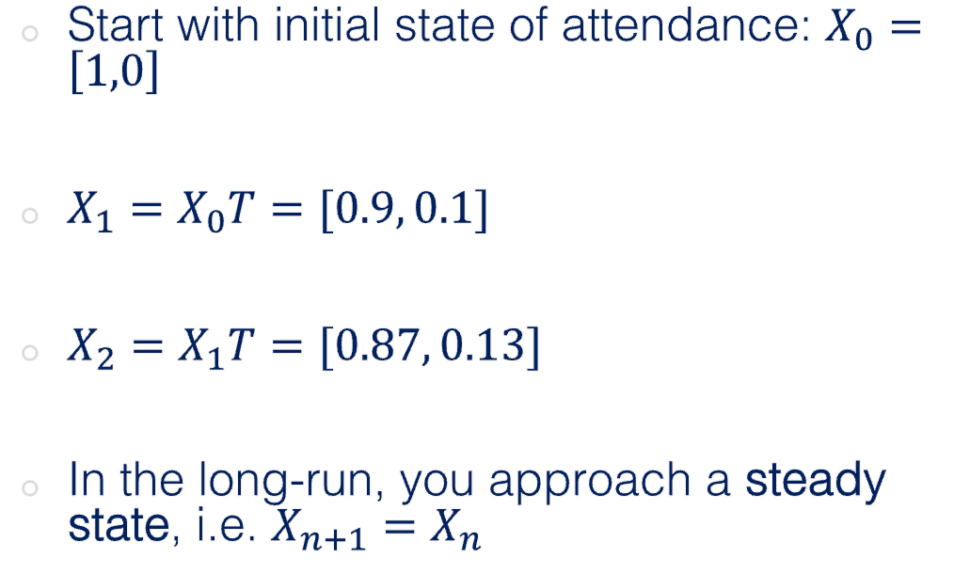
Markov Chains
0.9
Start with initial state of attendance: $X_{0}=\left[1,0\right]$
$X_{1}=X_{0}T=[0.9, 0.1]$
$X_{2}=X_{1}T=[0.87, 0.13]$
In the long-run, you approach a steady state, i.e. $X_{n+1}=X_{n}$
Attend
0.1
0.6
TO
Skip
attend
skip
0.4
attend
$$\begin{matrix}0.9 & 0.1 \\ 0.6 & 0.4\end{matrix}$$
FROM
skip
Transition matrix

Slide 16
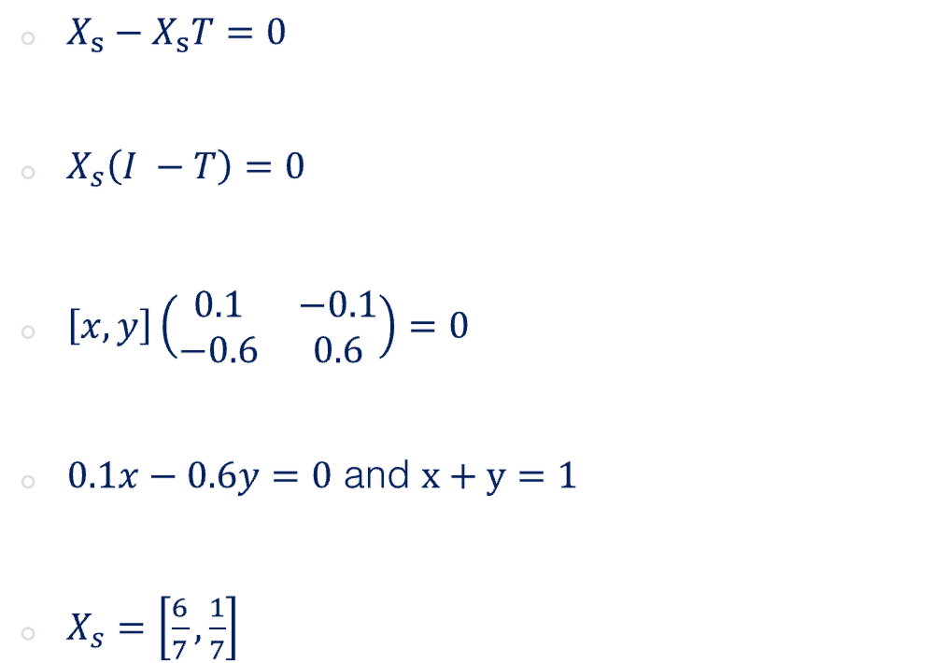
Markov Chains
0.9
$X_{s}−X_{s}T=0$
$X_{s}\left(I −T\right)=0$
$\left[x, y\right]\left(\begin{matrix}0.1 & −0.1 \\ −0.6 & 0.6\end{matrix}\right)=0$
$0.1x−0.6y=0$ and $x+y=1$
$X_{s}=\left[\frac{6}{7},\frac{1}{7}\right]$
Attend
0.1
0.6
TO
Skip
attend
skip
0.4
attend
$$\begin{matrix}0.9 & 0.1 \\ 0.6 & 0.4\end{matrix}$$
FROM
skip
Transition matrix

Slide 17
Markov Chains
Markov Chains can also be used to generate a sequence of random variables where the current value is dependent on the value of the prior value
An example of this is a number line, where possible moves are -1 and 1 (chosen with equal probability)
MCMCs are Monte Carlo methods where a Markov chain is used to draw samples
The idea is that the chain will settle (find equilibrium) on the desired quantity we are inferring

Slide 18
Challenge Eleven
0.76
Create a class that generates random numbers from a uniform distribution
Create a Markov Chain class that predicts which US party will win the next election (lookup matrices, matrix mutlipliaction, if statements etc.)
Assume initially a Dem is in power X0 = [1,0], create a method in the MC class that calculates numerically the steady state vector, i.e. the probability that in a given year
Create another method that uses random draws from the random number class to stochastically predict who will be in power for each of the next 20 cycles
Create a figure showing how the holder of office changed over the 20 cycles
Democrat
0.24
0.35
Republican
0.65

Slide 19

Group Project
Context: ballistics in the 1800s
Aim: determine the accuracy of various weapons at a given distance

Slide 20
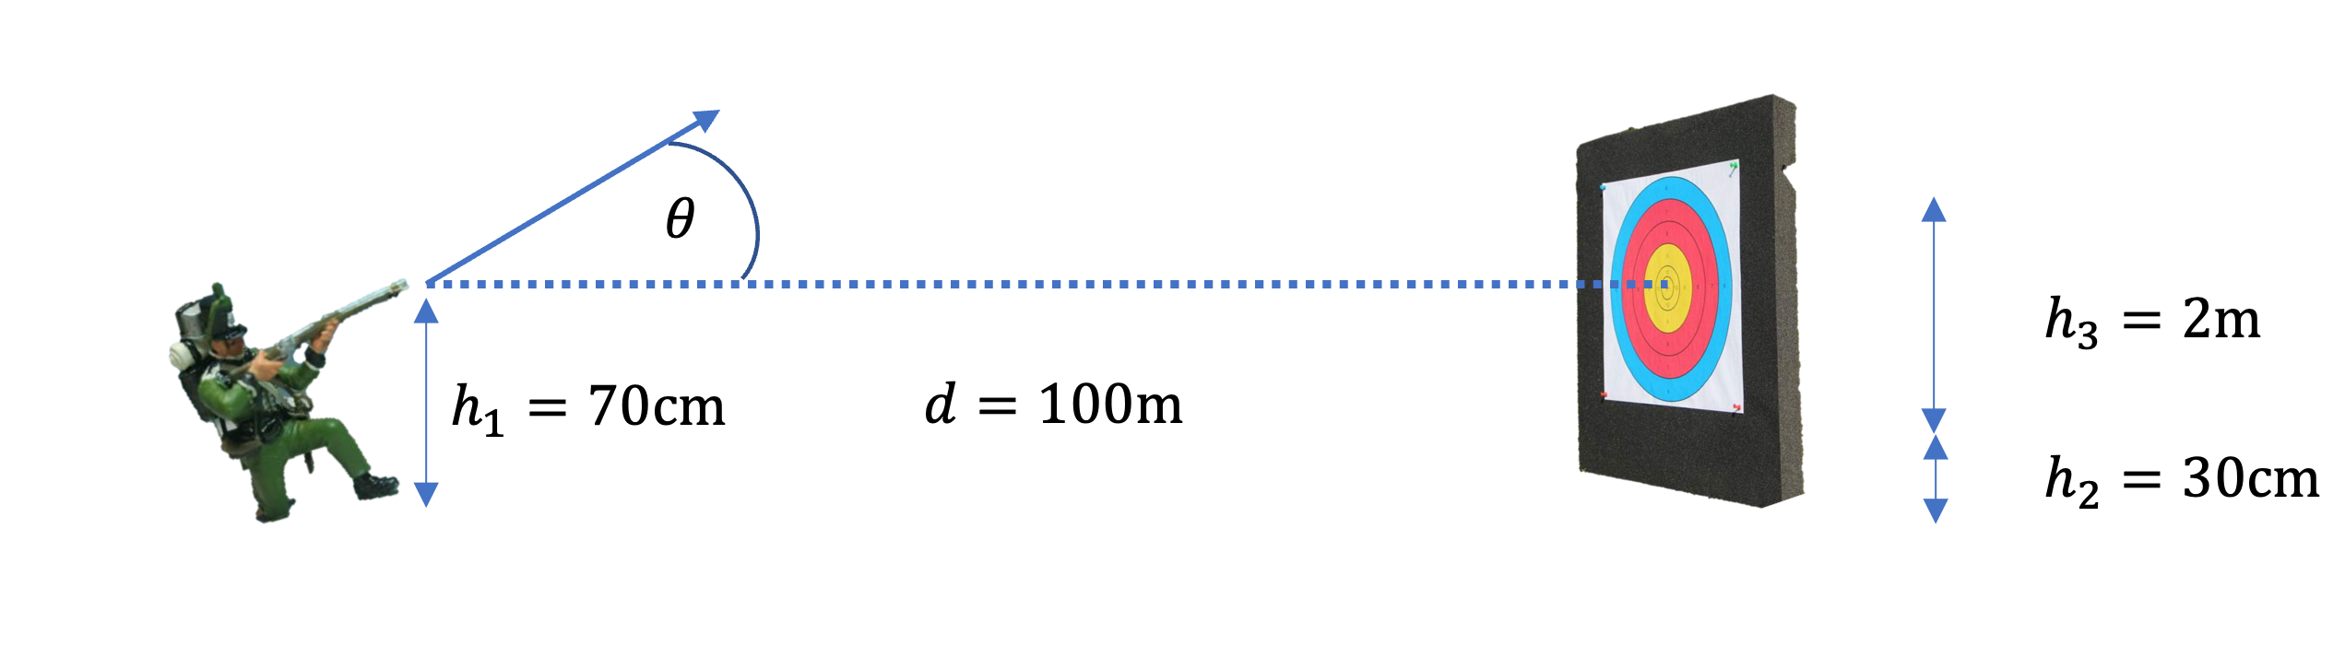
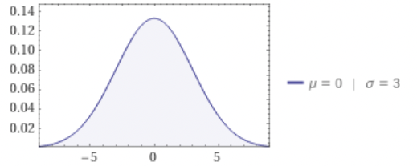

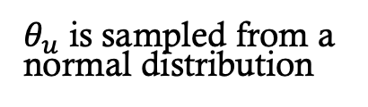
Project Description
$$θ=θ_{c}+θ_{u}$$
$θ_{u}$ is sampled from a normal distribution

Slide 21
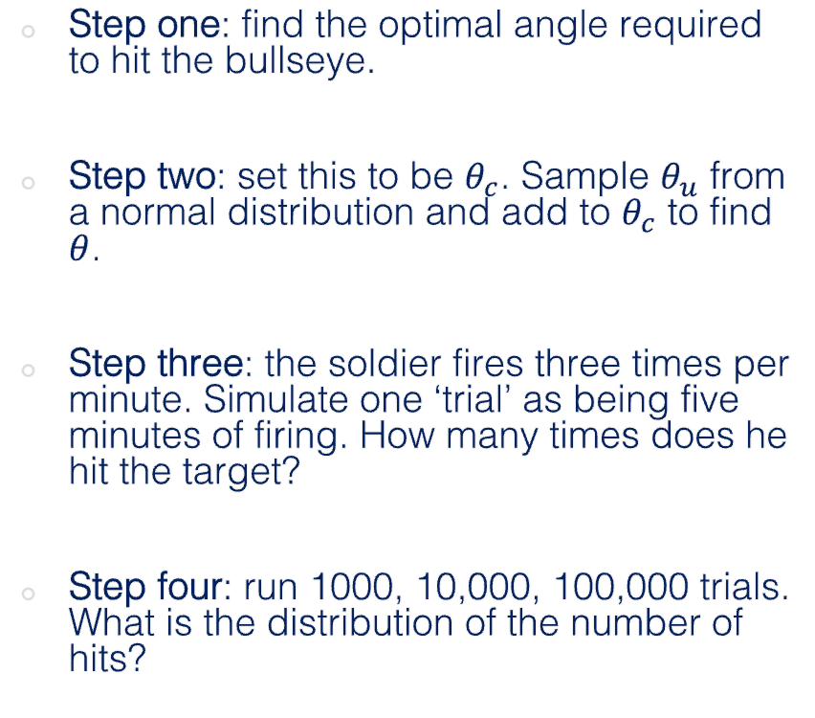

Project Description
Step one: find the optimal angle required to hit the bullseye.
Step two: set this to be $θ_{c}$. Sample $θ_{u}$ from a normal distribution and add to $θ_{c}$ to find $θ$.
Step three: the soldier fires three times per minute. Simulate one ‘trial’ as being five minutes of firing. How many times does he hit the target?
Step four: run 1000, 10,000, 100,000 trials. What is the distribution of the number of hits?
$$θ=θ_{c}+θ_{u}$$

Slide 22

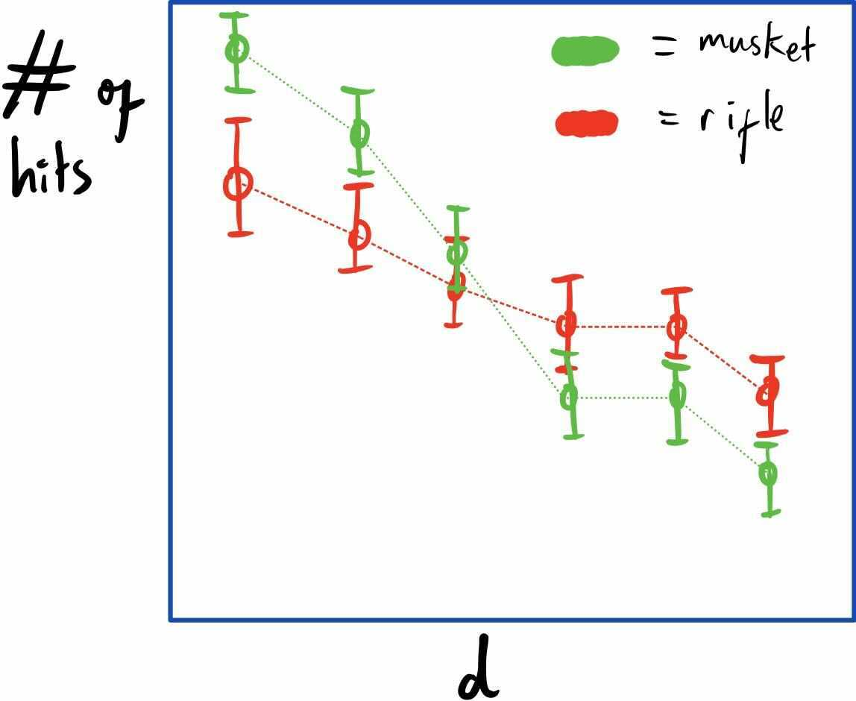
Project Description
Step five: compare the performance of a rifle vs a musket at 100m (details on the main document)
Step six: run the experiment for muskets and rifles at various distances. At what distance does it become better to use one over the other?

Slide 23
Project Description
Live demonstration on my laptop, will it compile and run first time?
  Produce data stream, save data, produce plots…

Slide 24
Tips
DRY – don’t repeat yourself!
Generalise things as much as possible, and consider where it would be useful to use classes
Plan your approach before you start coding
Communicate via Slack, or book study rooms in the teaching hub (502)
Try using GitHub if the project becomes complex

Slide 25
Your Project
Group One
  John
  Naomi
  Rosie
  Shoaib
Group Two
  Ben
  Jak
  Shirsendu
  Matthew
Group Three
  Pawan
  Stephen
  Salma
  Archie
  Liam
Room:

Slide 26


